Slide 1

IMAGE AND VIDEO COLORIZATION USING GENERATIVE ADVERSERIAL NETWORKS
Şevval Bulburu 19011038
Mehmet Alperen Ölçer 20011023

Slide 2
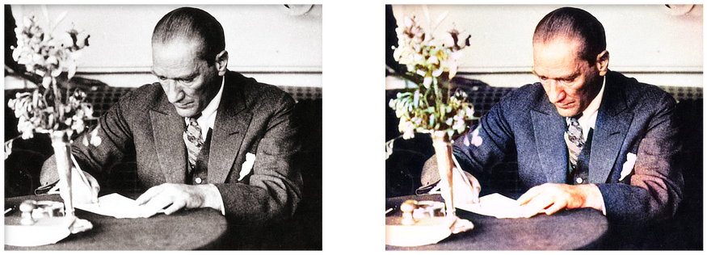
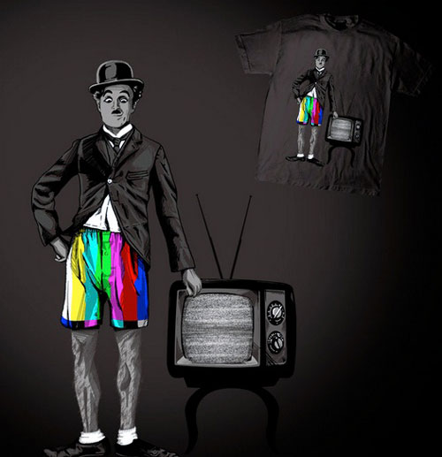
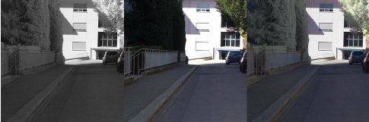
SCOPE OF THE ProjECT
Conquer the world

Slide 3
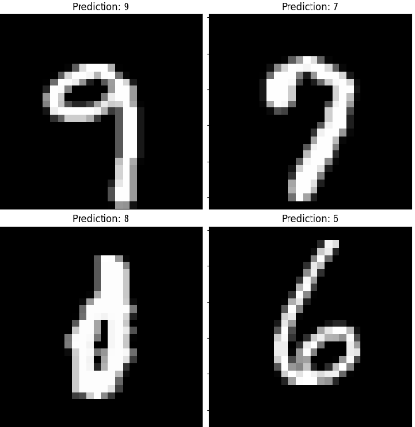
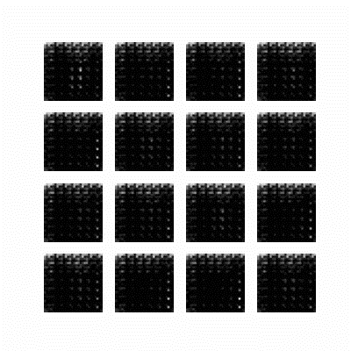
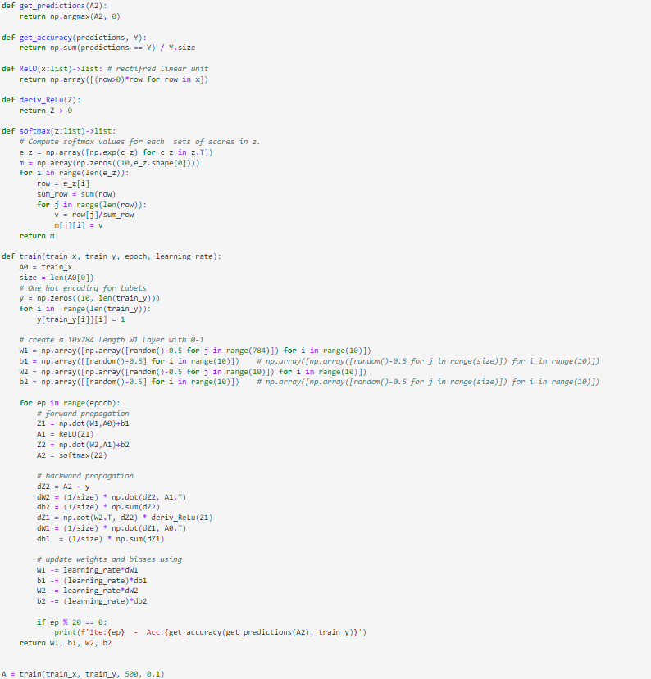
BUILDING KNOWLEDGE COMPETENCE

Slide 4
LITERATURE REVIEW
Paper | Model | Dataset | Performance
Learning Representations for Automatic Colorization | VGG-16 - ImageNet | Pascal Dataset | SSIM: - PSNR: 24.25
GAN-based image colorization for self-supervised visual feature learning | cGAN | COCO Dataset | SSIM: 0.85 PSNR: 20.94
Image Colorization Using Generative Adversarial Networks and Transfer Learning | VGG19 - ImageNet | DIV2K | SSIM: - PSNR: 22.52
VCGAN: Video Colorization With Hybrid Generative Adversarial Network | VCGAN | DAVIS Videvo | SSIM: 0.92 PSNR: 23.77 SSIM: 0.93 PSNR: 25.11
Ours | Specified GAN | CIFAR-10 Hababam Sınıfı Documentary | SSIM: 0.92 PSNR: 23.30 SSIM: 0.96 PSNR: 27.30 SSIM: 0.95 PSNR: 25.35

Slide 5
DATASETS
CIFAR-10
HABABAM SINIFI
DOCUMENTARY
Contains
60.000 images.
32x32 pixel
Contains
128x128 pixel
25.000 images.
Contains
128x128 pixel
150.000 images.
CIFAR-10 Dataset was used for image colorization.
Hababam Sınıfı and Documentary Datasets were used for video colorization.

Slide 6
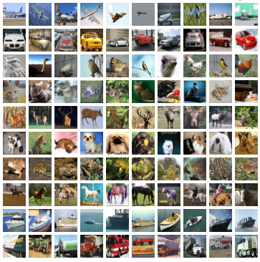
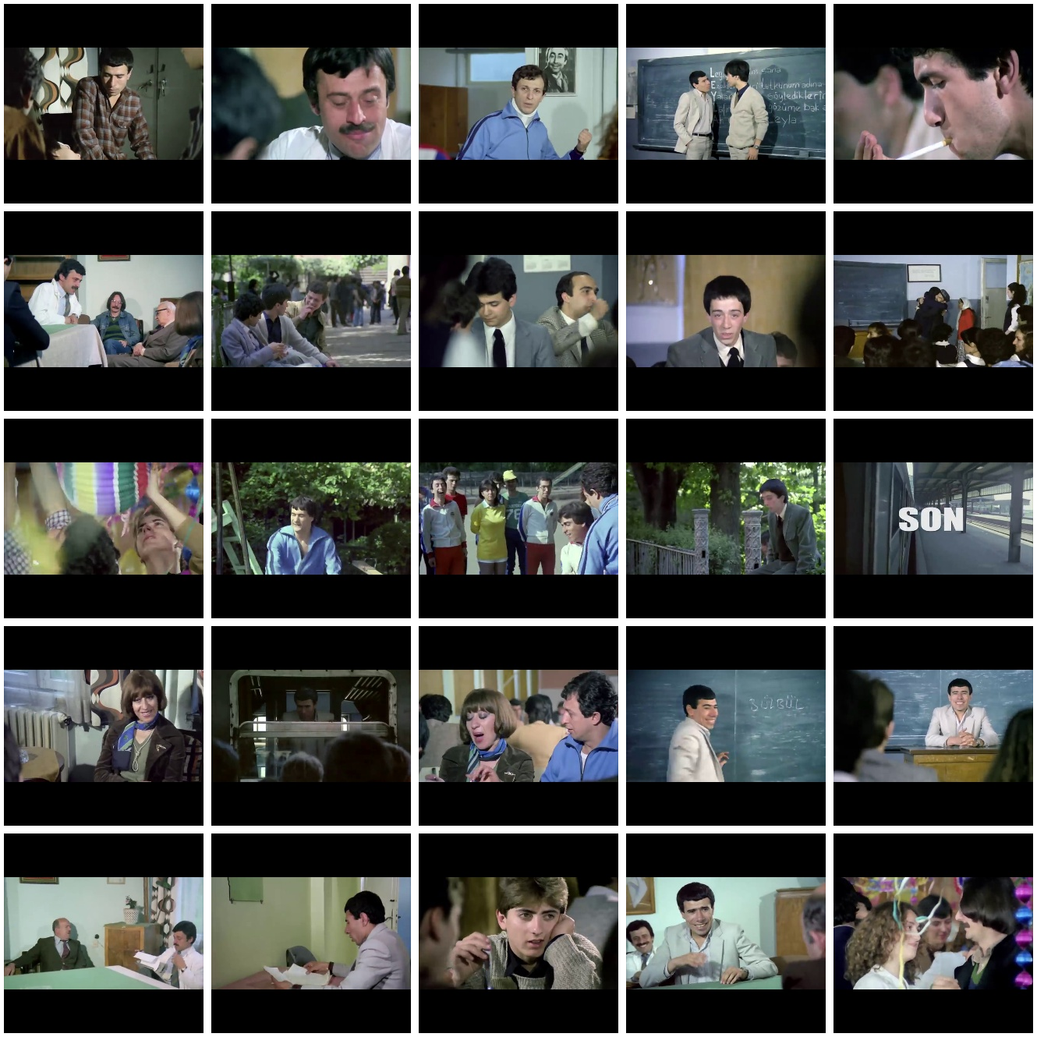
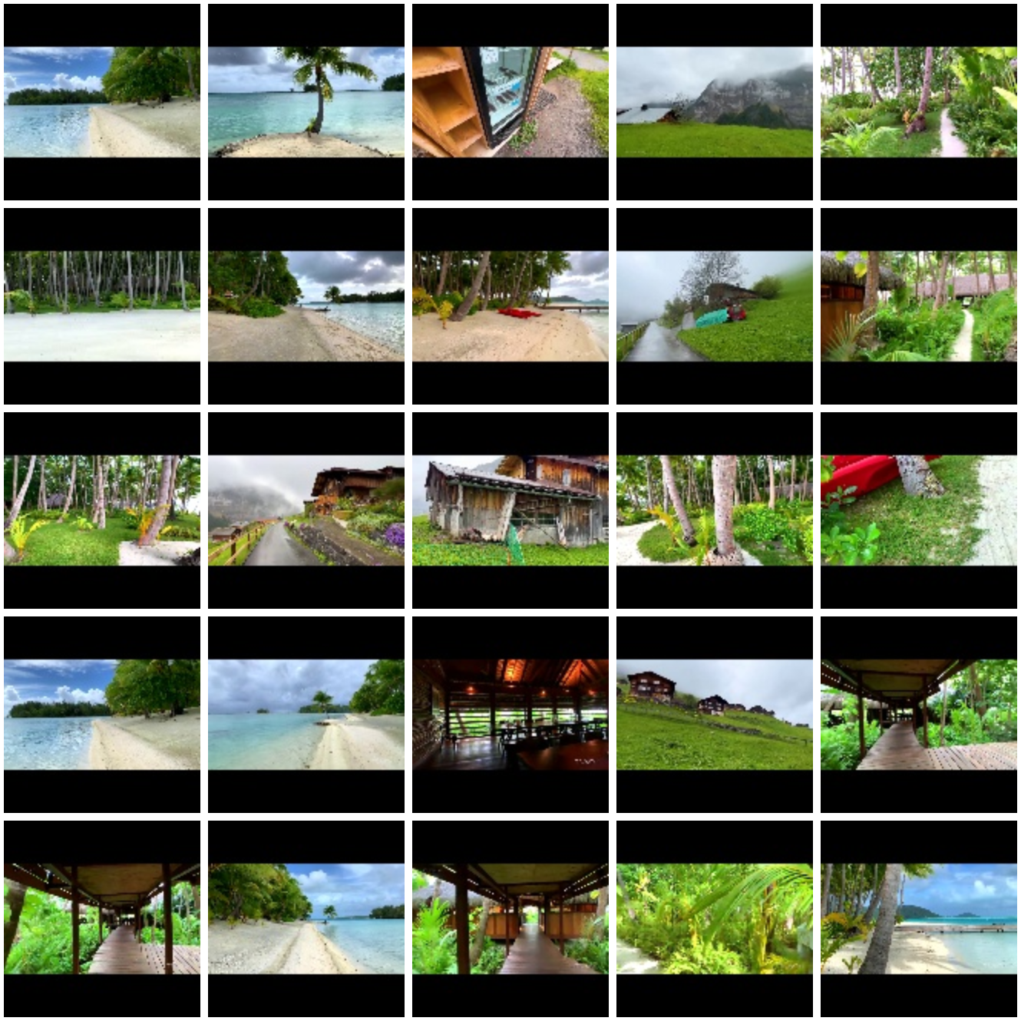
EXAMPLE FROM DATASETS
CIFAR-10
HABABAM SINIFI
DOCUMENTARY

Slide 7
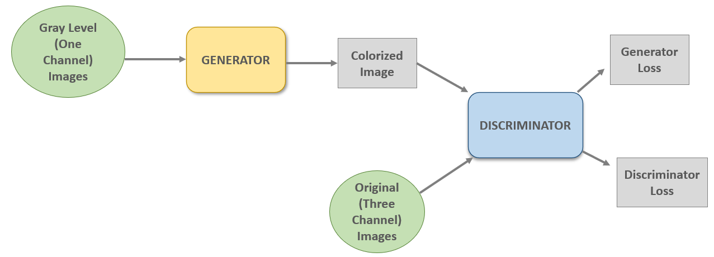
GAN ARCHITECTURE
MIN-MAX FUNCTION

Slide 8
PROJECT STEPS – IMAGE COLORIZATION
Pre-processing on CIFAR-10 Dataset
GAN MODEL - TRAINING
TEST
Grid-Search
The Best Model

Slide 9
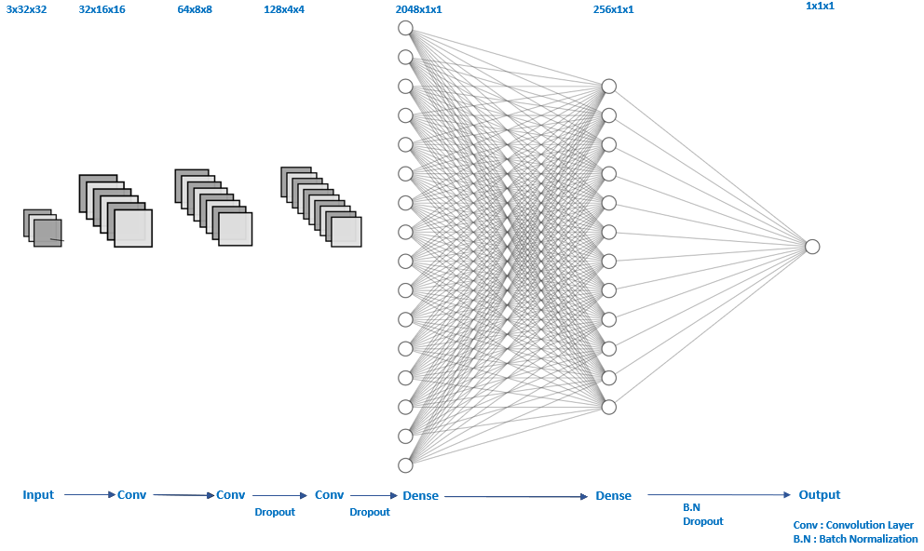
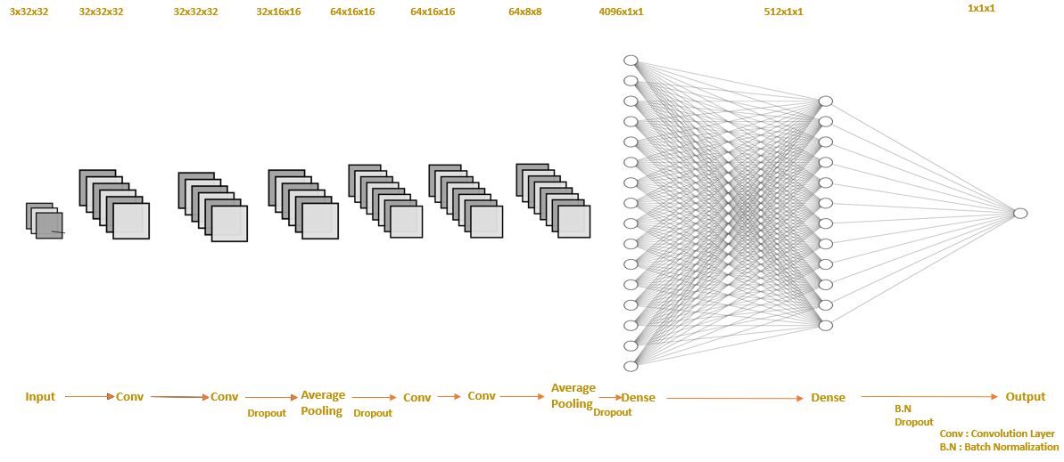
Discriminator-1
Discriminator-2

Slide 10
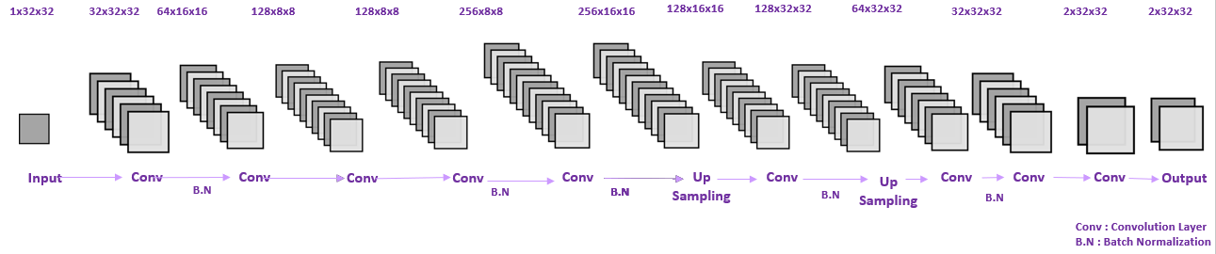
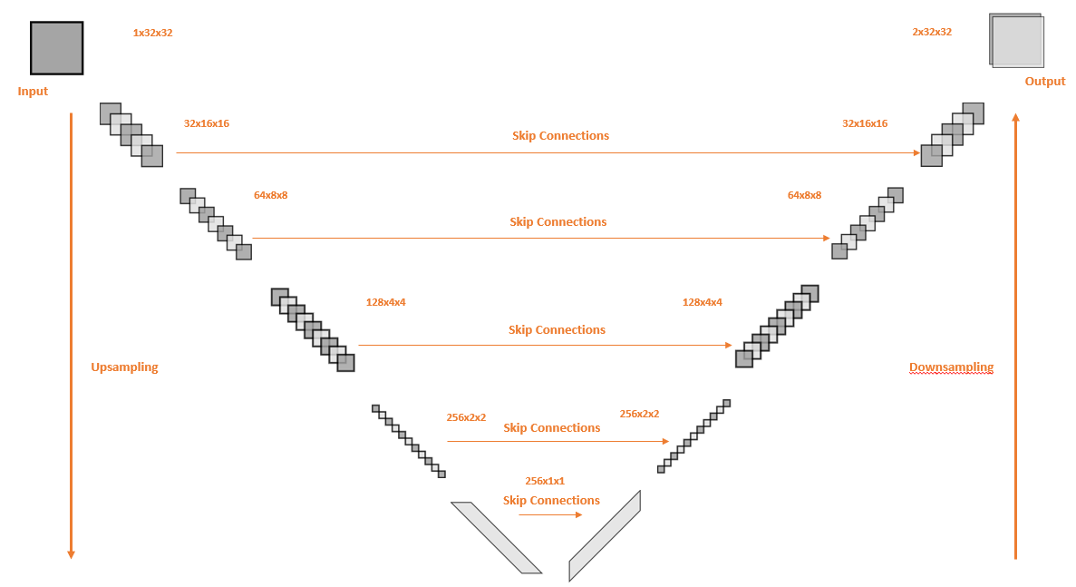
GENERATOR-1
GENERATOR-2

Slide 11
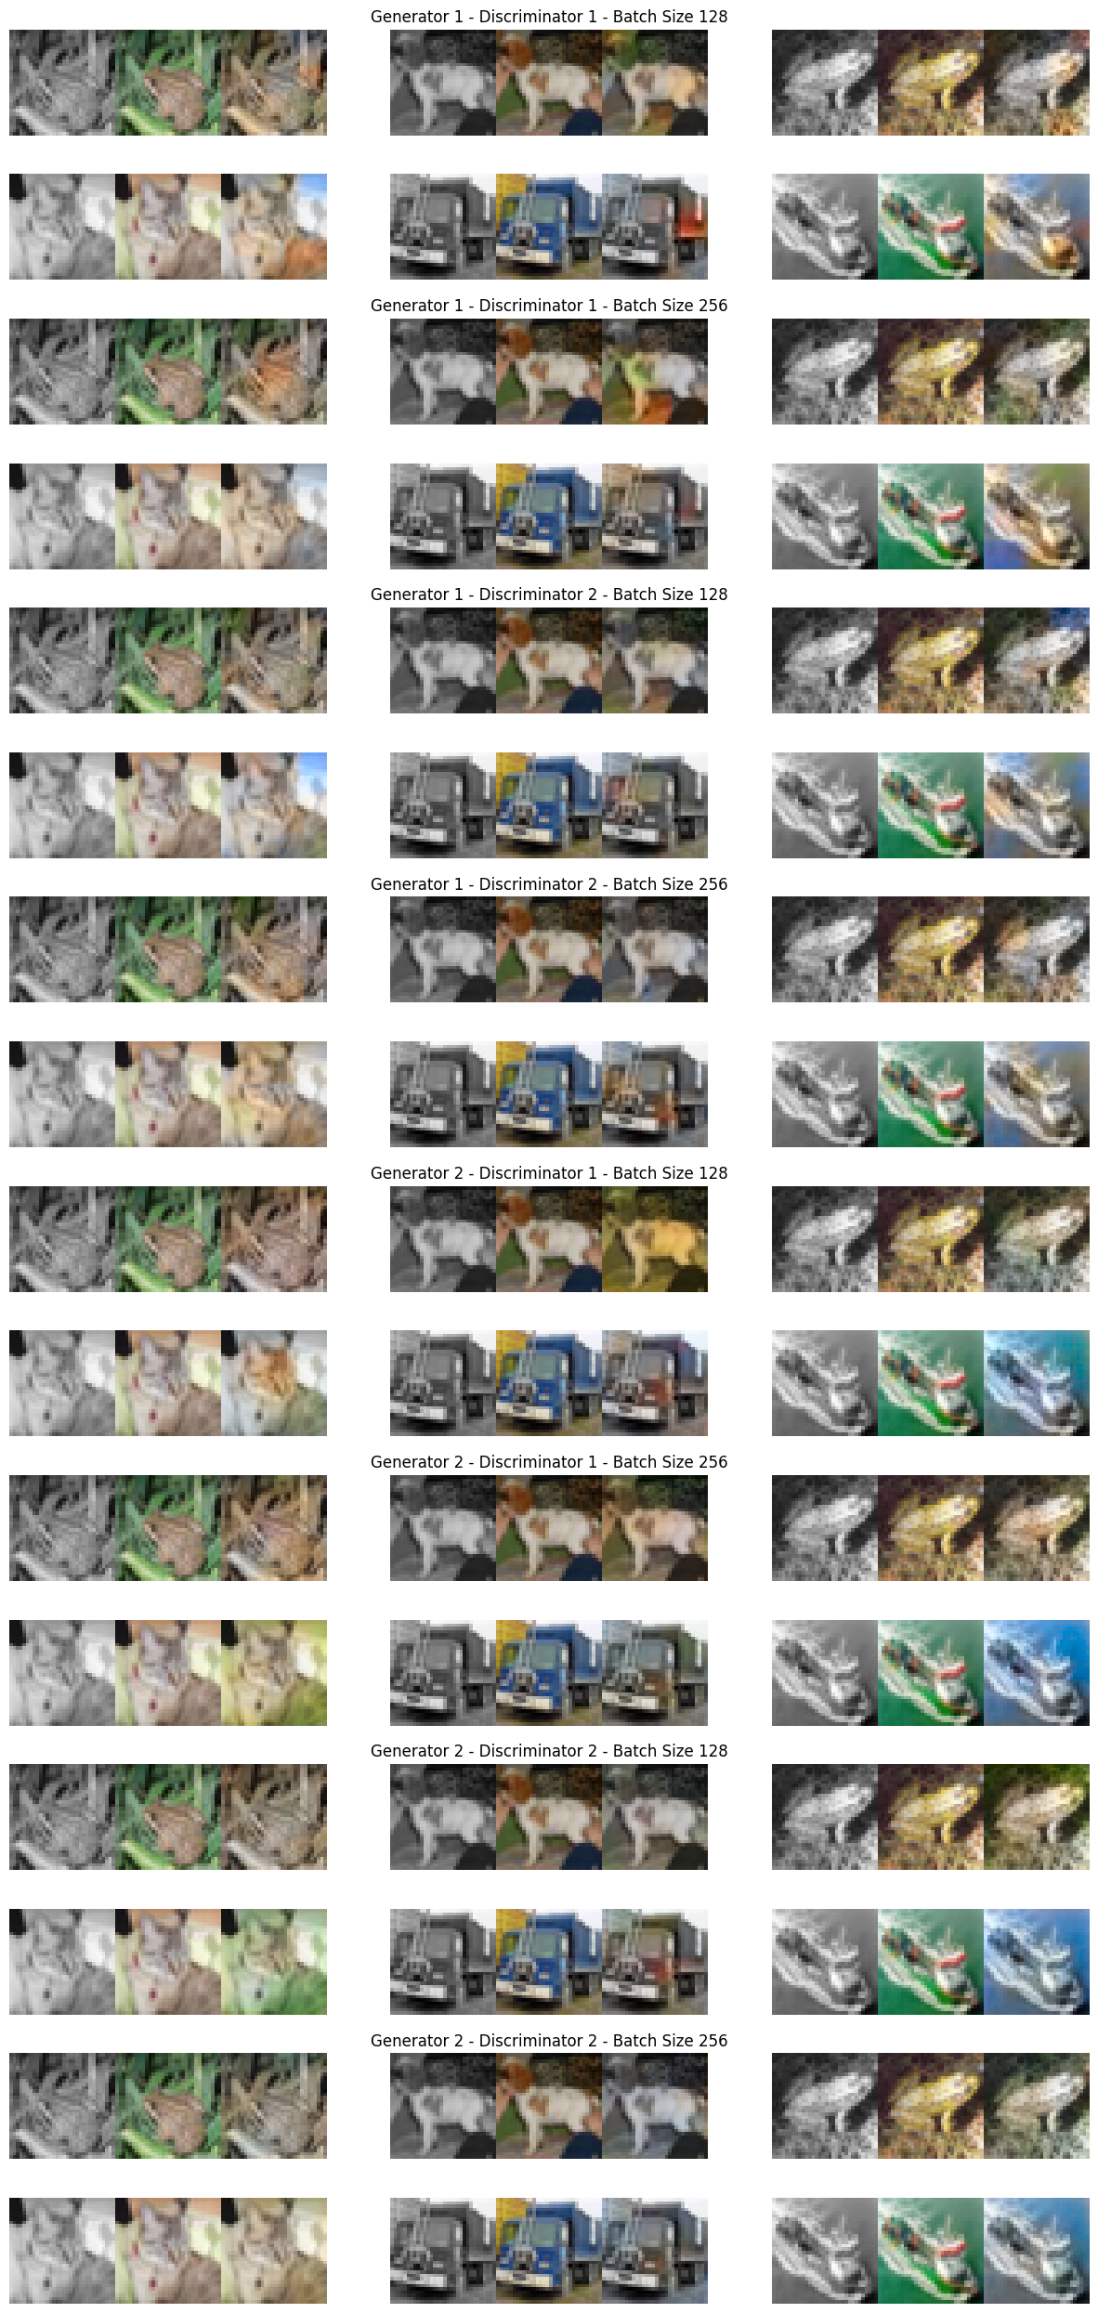
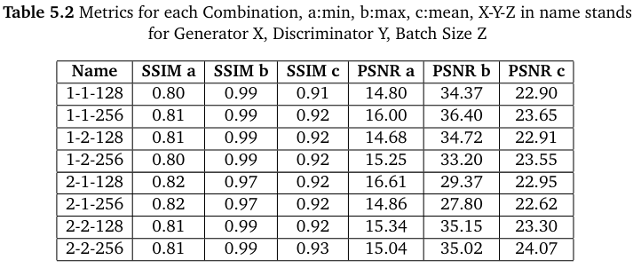
Experımental resultS on Cifar-10

Slide 12
PROJECT STEPS – VIDEO COLORIZATION
Independent GAN Training
Video Source
Dataset Creation by
Frame Extraction
Dataset Pre-Processing
Video Colorization Structure
Dependent GAN Training

Slide 13
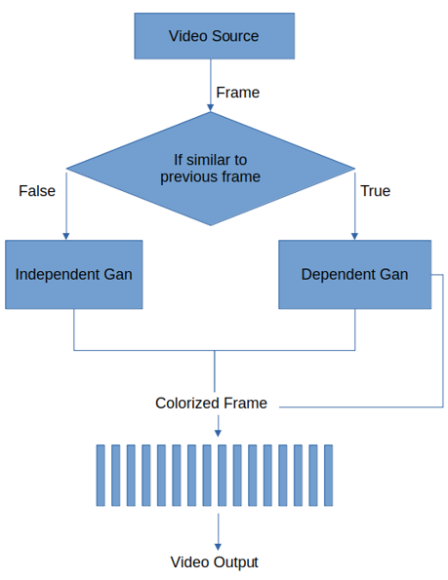
PROJECT STEPS – VIDEO COLORIZATION
Video Colorization Structure
Scene Change Detection
Frame 1
Frame 2
Compare Histograms and SSIM scores
Continious frames
Scene Change

Slide 14
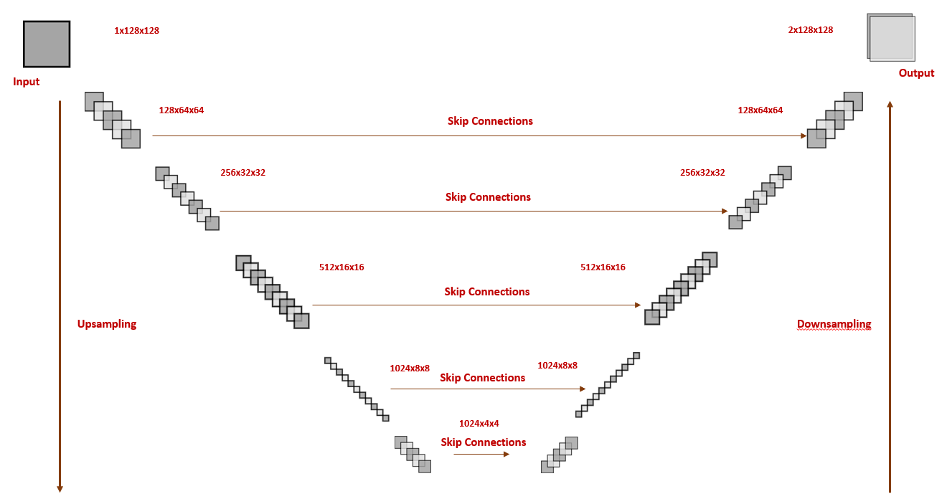
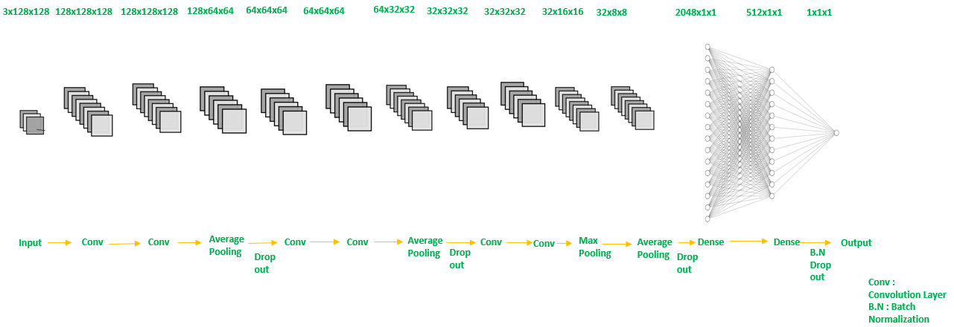
INDEPENDENT-Dependent Gan MODELS
GENERATOr
Discriminator

Slide 15
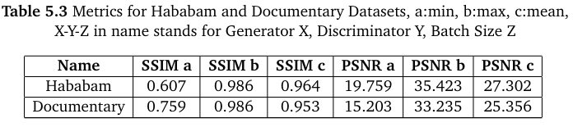
Experımental resultS on 128x128 DATASETS
https://drive.google.com/file/d/1oSKEDODvLJEQZi1mq5UbHO3LSSNfvaXF/view?usp=
https://drive.google.com/file/d/1W\_h0QmoZuGdbQSq9S\_stEcw9p-ggDgaA/view?usp=sharing
https://drive.google.com/file/d/14HQfcIGf\_brzKGtOWZg9sYzcC1w99L5s/view?usp=sharing

Slide 16
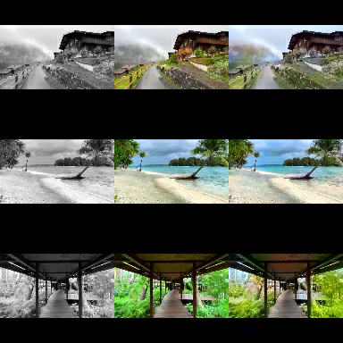
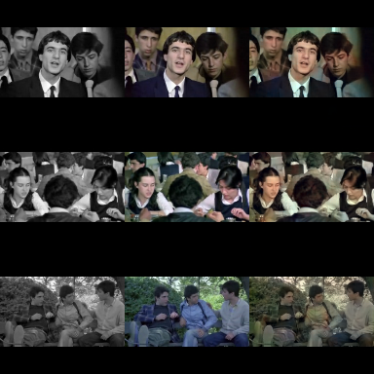
Successfull results on 128x128 DATASETS
Documentary Dataset
Hababam Dataset

Slide 17
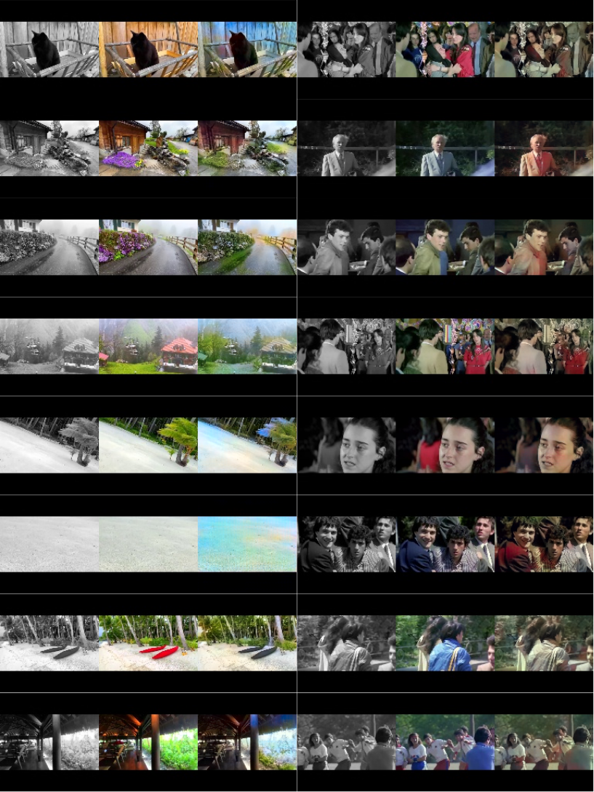
Unsuccesfull results on 128x128 DATASETS
Documentary Dataset
Hababam Dataset

Slide 18
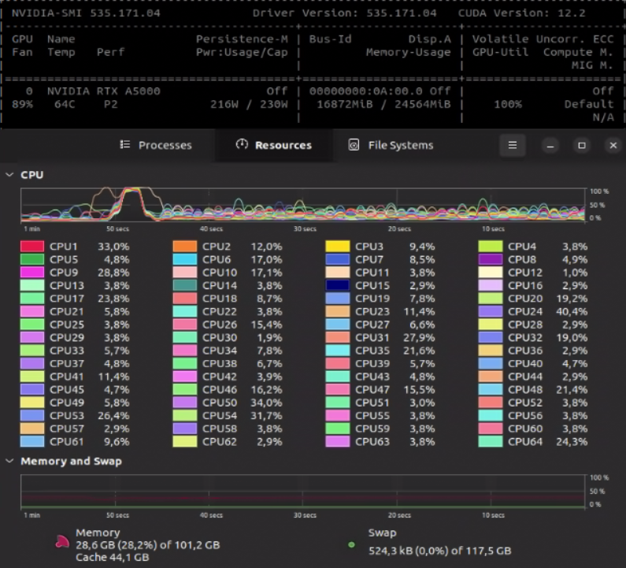
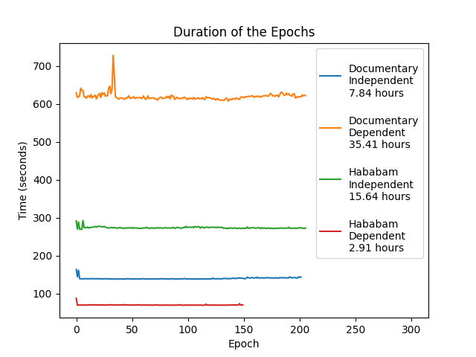
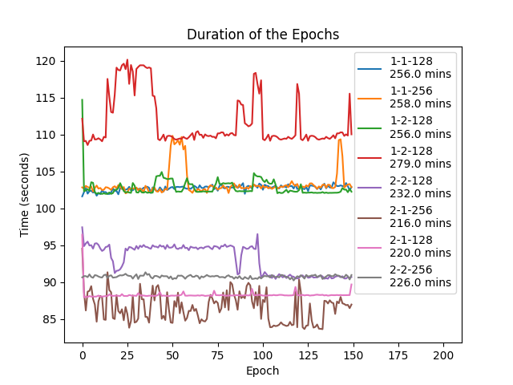
Resource Usage and Performance
Dependent model time: 21.7 miliseconds
Independent model time: 577.7 miliseconds
Scene change detection time: 4.6 milliseconds
In performance testing 1000 frames coloring process took 27 seconds which gives us an average FPS: 37.

Slide 19
PROJECT STEPS – Next research options
Object Classification + Colorization
Different color space
Bigger Dataset

